Slide 1
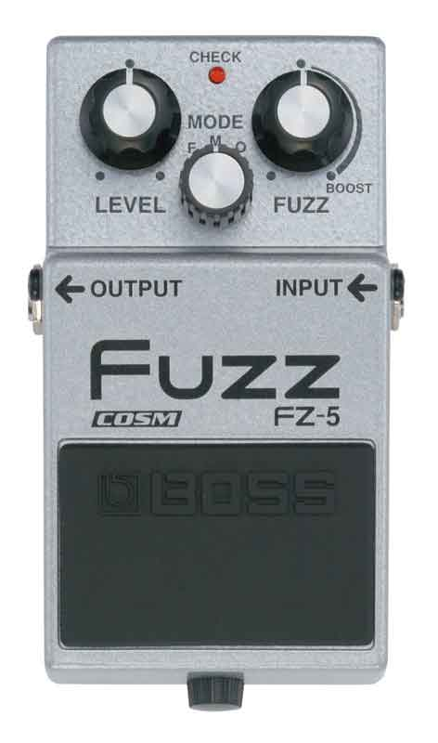
Logical Fuzzing
Richard Johnson | switech@microsoft.com

Slide 2
Welcome
Introduction
Agenda
The Business of Fuzzing
Fuzzing Technology
Architecting a Framework
Bennu Concept Tool

Slide 3
Fuzzing As We Know It
Fuzzing is a method of software testing
A high volume of exceptional data is sent to various interfaces of a target to locate faulty program logic
Simple in concept, complex in practice
Hundreds of fuzzers have been written
Fuzzing has held up in practical testing
Many thousands of bugs have been identified

Slide 4
From a Business Perspective
Identifying flaws in software is critical to the reliability and security of our information systems
Security critical bugs are very expensive to fix in deployed products
Fuzzers produce repeatable results useful for regression testing
Fuzz testing is part of the SDL best practices
Fuzzers are very cheap and very effective!
Fuzzers are responsible for 70% of the bugs Microsoft patched in 2006
Fuzzers are responsible for the majority of the “month of” bugs
Fuzzers are responsible for the IFRAME bug, the .printer bug, etc

Slide 5
Comparing Methodologies
Manual Data Flow Analysis
Can be performed on any form of code
Produces an undefined number of bugs
Manual efforts are not repeatable or scalable
Very expensive and limited source of engineers
Static Data Flow Analysis
Can target classes of bugs
Automated and repeatable
High false positive rate
Lacking effective algorithms
Dynamic Data Flow Analysis
Can target classes of bugs
Automated and repeatable
Solves some problems with static analysis
Lacking effective algorithms*
int main ( int argc, char **argv )
{
FOO_STRUCT foo;
...
foo.val = strdup(argv[1]);
foo.sz = strlen(foo.val);
...
vuln(&foo);
}
void vuln ( struct *foo )
{
char buf[STATIC_SIZE];
...
strncpy(buf, foo->val, foo->sz);
}

Slide 6
Fuzzing Technology

Slide 7
Initial Public Offering
Barton Miller, et al “An Empirical Study of the Reliability of UNIX Utilities”, 1990
Introduced “fuzz”, the first dumb fuzzer
Fuzzed with unstructured, random data
Targeted command line argument parsing on 90 console utilities in 7 UNIX varieties
Results: 25% – 33% of the utilities tested crashed, depending on the version of UNIX
“Our approach is not a substitute for a formal
verification or testing procedures, but rather an
inexpensive mechanism to identify bugs and
increase overall system reliability.”

Slide 8
Initial Public Offering
Miller tried again in 1995 with improvements
X Windows clients
Network ports
Memory exhaustion simulation
Crashed as many as 40% of the console utilities and 25% X windows clients
None of the network facing code faulted
“Our 1995 study surprised us ... the continued prevalence of bugs in the basic UNIX utilities seems a bit disturbing. The simplicity of performing random testing and its demonstrated effectiveness would seem to be irresistible to corporate testing groups.”

Slide 9
Valuable Input
Miller, inspired by the storm, used random input data
Mutation based input performs transformations on existing protocol data
Static lists of values are used to target common implementation defects and known classes of bugs

Slide 10
Smarter Fuzzing
Fuzzing interfaces with unstructured inputs will yield limited results
Structured inputs allow for more effective traversal of program states
This is where the art of fuzzing begins

Slide 11
You be the Smart, I’ll be the Fuzz
SPIKE, Dave Aitel, 2002
C language API for data generation and rapid network client development
Structured data dynamically defined as blocks
Relation model for size fields
Peach Fuzzer Framework, Michael Eddington, 2004
Object oriented python API
Improved block based analysis with an abstracted fuzzing model

Slide 12
You be the Smart, I’ll be the Fuzz
Peach Fuzzer Components
Generators
Primitive or complex block data generators
Transformers
Static encoders or decoders associated with a generator
Protocols
State logic is implemented using generators
Publishers
Provide a transport for the target protocol

Slide 13
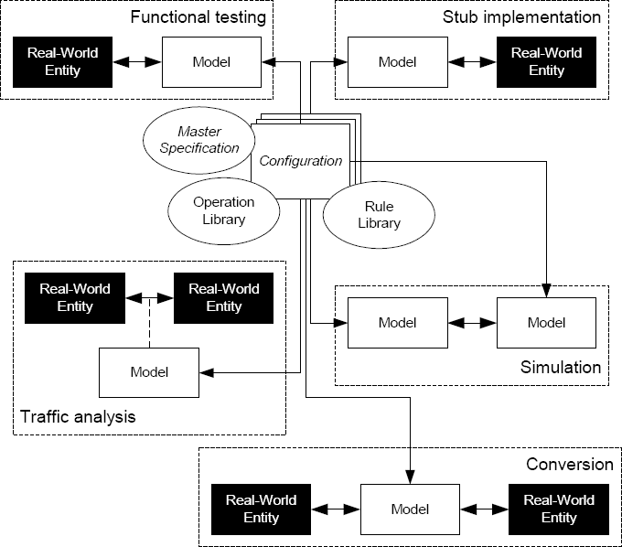
Meanwhile in Academia
PROTOS, 2002 Functional fuzzing using behavior models
PROTOS Mini-Simulation Concept
Master Specification
BNF notation utilized to describe interaction models and syntax models
Configuration
Performs operations on the master specification to derive a Mini-Simulation model
Communication Rules
Connect the model to execution environment
“A Functional Method for Assessing Protocol Implementation Security”, Rauli Kaksonen

Slide 14
Meanwhile in Academia
Entity Modeling
Describes internal behavior of an entity
Standards
Specification and Description Language (SDL)
Unified Modeling Language (UML)
Interaction Modeling
Describes behavior between two entities
Standards
Unified Modeling Language (UML)
Tree and Tabular Combined Notation (TTCN)
Message Sequence Chart (MSC)
Syntax Modeling
Describes the structure of data exchanged by entities
Standards
Abstract Syntax Notation One (ASN.1)
Extensible Markup Language (XML)

Slide 15
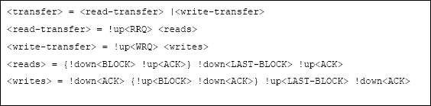
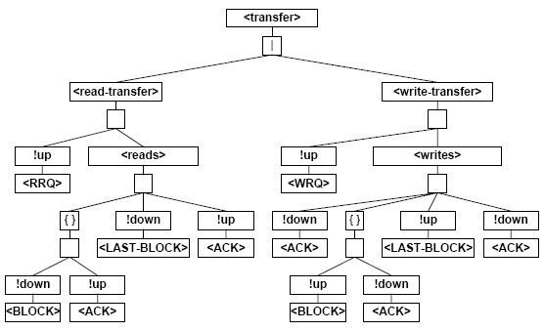
Behavior Modeling
Backus-Naur Form (BNF)
Flexible context-free grammar extension to regular expressions
Lacking standard notation
Simulation Grammar
Attribute grammar using modified BNF notation
Tree-based Data Productions
Tags represent callbacks such as input triggers
PROTOS Mini-Simulation Behavior Grammar (TFTP)
PROTOS Mini-Simulation Behavior Tree (TFTP)

Slide 16
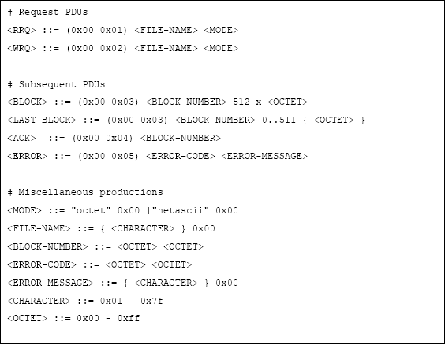
Syntax Modeling
Syntax Grammar
Also uses modified BNF
Tree-based Type Productions
Evaluation
Transforms input grammar to output grammar
Engine traverses input tree, executing rules on subtrees
Semantic Rules evaluate data
Communication Rules implement I/O
PROTOS Mini-Simulation Syntax Grammar (TFTP)

Slide 17
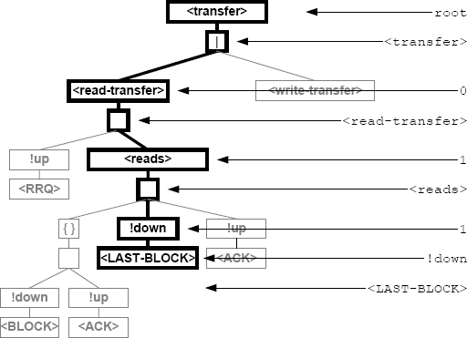
State Traversal
Path Finding
Paths are used to access elements of the grammar
Masks can be used as an optimized path representation
PROTOS Mini-Simulation Path Representation
<transfer>.0.<read transfer>.1.<reads>.1.!down.<LAST-BLOCK>

Slide 18
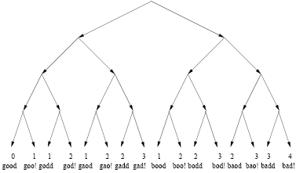
Dynamic Whiteboxing
Scalable, Automated, Graph Executution (SAGE) “Automated Whitebox Fuzz Testing”, Godefroid, Levin, Molnar 2006
Runtime state of a recorded session is stored for analysis
Symbolic execution gathers input constraints from conditional statements
Solution given by known-good input data is negated and solved again
Generational vs Depth-First Search (DFS) algorithms
void top(char input[4])
{
int cnt = 0;
if (input[0] == ‘b’) cnt++;
if (input[1] == ‘a’) cnt++;
if (input[2] == ‘d’) cnt++;
if (input[3] == ‘!’) cnt++;
if (cnt >= 3) abort();
}

Slide 19
What’s Missing?
Abstraction
Existing behavior model research is not being utilized
Automation
Current technology not fit for production use
Manual processes introduce inconsistent results
Unification
Commonalities in desired functionality have not been assessed
Lack of a common platform prevents useful integration of existing research tools

Slide 20
Architecting a Fuzzing Framework

Slide 21
Fuzzer Engines
Fuzzer Engines can be classified by features:
Input Generation
Random or Mutation or Static
Data Model
Unstructured or Structured
Behavior Model
Stateless or Stateful
The desired platform should support the creation of both simple and complex fuzzers

Slide 22
A Note About Input Generation
Reproducibility is crucial
Multiple passes of data generation is ideal to target known classes of bugs first
Fuzzers should be able to run for an infinite time but cover the critical space quickly
Extended model for generation sequencing would be ideal

Slide 23
Fuzzer Development Phases
Behavior Modeling
Testing and Analysis
Target Profiling
Data Modeling

Slide 24
Target Profiling
Behavior Modeling
Testing and Analysis
Target Profiling
Data Modeling
Manual Analysis
Protocol Specifications
Static Analysis
Type and Symbolic Debug information
Execution Flow Graphs
Data Flow Graphs
Dynamic Instrumentation
Interface discovery
Indirect execution and data flow
Sample input data
File harvesting
Traffic Analysis

Slide 25
Data Modeling
Behavior Modeling
Testing and Analysis
Target Profiling
Data Modeling
Notation for behavior modeling should be abstract enough to represent both data and behavior
ASN.1 is cumbersome and not human readable, and cannot model behavior.
PROTOS’s modified BNF grammar looks highly capable
XML serialization is widely supported making it a good option

Slide 26
Behavior Modeling
Behavior Modeling
Testing and Analysis
Target Profiling
Data Modeling
PROTOS interaction model is robust and useful
New research is on-going in using XML to represent state models
“XML Graphs in Program Analysis”, Anders Møller, et al
GXL Schema

Slide 27
Testing and Analysis
Behavior Modeling
Testing and Analysis
Target Profiling
Data Modeling
Target Instrumentation
Debugger Engine
Logging
Callbacks and Exception Handling
Result Analysis
Analysis using standard debugging Tools
Visualization for manual analysis

Slide 28

Bennu: A Concept Tool
http://www.globalegyptianmuseum.org/detail.aspx?id=13824

Slide 29
Bennu Goals
State of the Art
Identify and use the best research concepts available for fuzz testing
Flexible & Reusable
Framework should be able to be used to create any of the types of fuzzers in common use today
New fuzzers should have access to previous models
Intelligent
Use profiling information when present
Do not require any special information to execute

Slide 30
Bennu Goals
Approachable
Users should not need to write much code or understand how internal models work
Customizable
Target Profiling and Testing Analysis should be pluggable
Scalable
Distributed testing should be possible

Slide 31
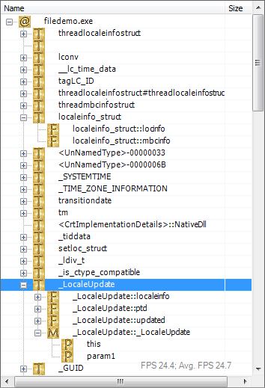
Assisted Target Profiling
Static analysis engine powered by Phoenix*
Symbols
Types
Imports
Control Flow
Data Flow
Dynamic analysis engine powered by Microsoft Debug Engine (dbgeng.dll)
Run-time compiled Target Analyzers written in C# perform analysis functions with the static and dynamic engines

Slide 32
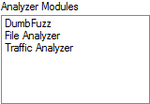
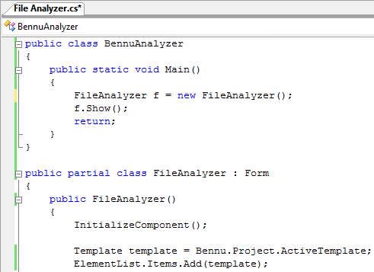
Assisted Target Profiling
Static analysis engine powered by Phoenix*
Symbols
Types
Imports
Control Flow
Data Flow
Dynamic analysis engine powered by Microsoft Debug Engine (dbgeng.dll)
Run-time compiled Target Analyzers written in C# perform analysis functions with the static and dynamic engines

Slide 33
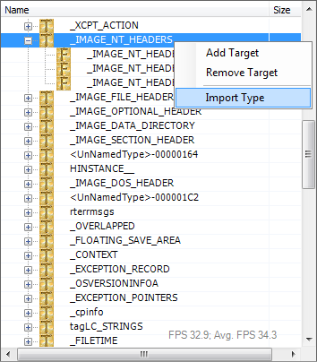
Assisted Data Modeling
XML Data Model
Structured template definitions
Type specification
Extended relationship model
Developed in cooperation with Mike Eddington, supported by Peach 2.0

Slide 34
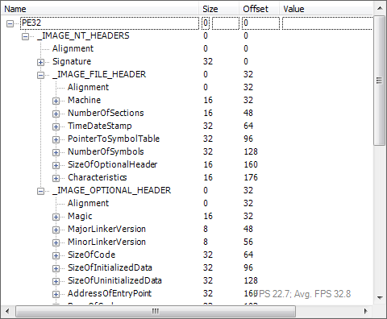
Assisted Data Modeling
XML Data Model
Structured template definitions
Type specification
Extended relationship model
Developed in cooperation with Mike Eddington, supported by Peach 2.0

Slide 35
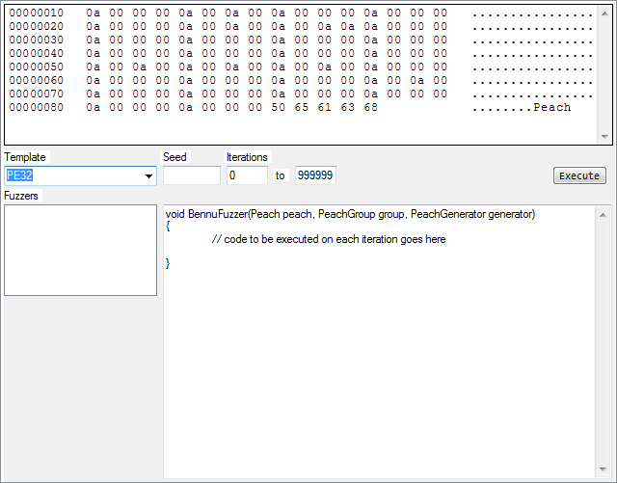
Assisted Behavior Modeling
XML Model
Evaluations use callbacks
State model abstraction currently being developed
Developed in cooperation with Mike Eddington, supported by Peach 2.0
UNDER DEVELOPMENT

Slide 36
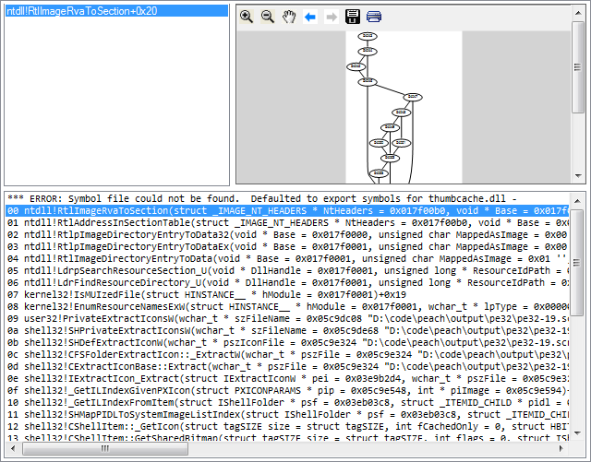
Automated Testing and Analysis
Tests executed by Peach 2.0 running on an embedded Python engine
Exception handling and post-run analysis using the Dynamic Analysis Engine
Quickly inspect minidump contents
View visited code blocks
Register callbacks for automated post-run analysis

Slide 37
Conclusions
Fuzzing is an increasingly powerful approach to software security
Available support libraries are sufficiently robust to build complex analysis frameworks
Academic research has revealed technology possibilities that have yet to be fully realized
Automating the abstraction of behavior models provide an ideal area of research for security engineers

